Slide 1
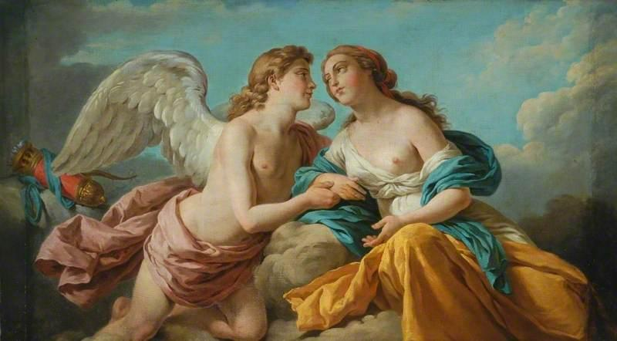
Cupid & Psyche
Group members:
10252055劉沁璇 10442008李羿緯 10442007洪正儒 10442036連聖哲 10442020范心怡 10442012王雅淳
10442024何亮玟 10442028汪韋廷 10442039李熙雯
10442032李宗穎 10342038胡張善群

Slide 2
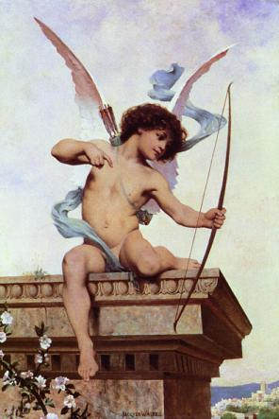
Cupid ( Eros )
The god of desire
Son of love goddness Venus & the war god Mars
A person who is shot by Cupid’s arrow is filled with uncontrillable desire
邱彼特 ( 厄洛斯 )
象徵慾望之神
女神VENUS 與 戰神MARS 之子
只要被邱比特的箭射到,就無法控制自己的慾望

Slide 3
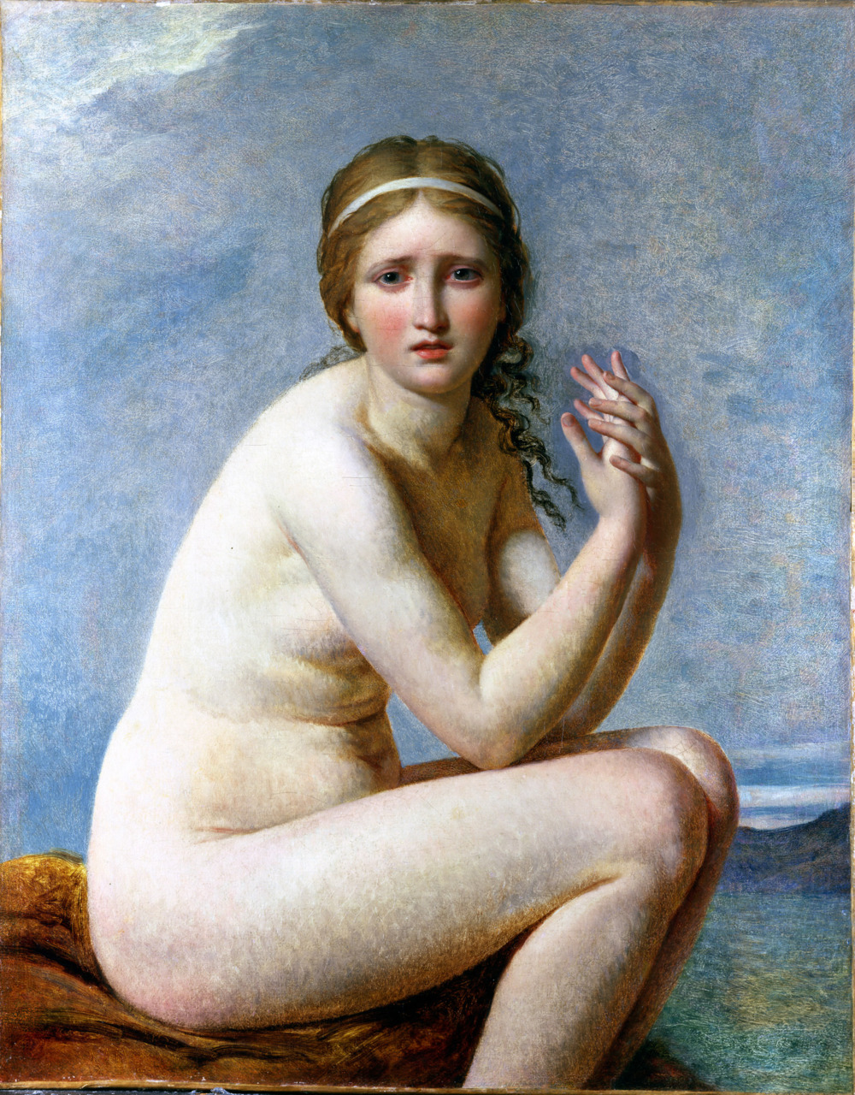
Psyche A mortal girl Cupid’s wife Her pretty charming were even surmounted than the Beauty Goddess of Venus Goddess of the soul
賽姬 一位凡間的少女 邱彼特的老婆 其美麗更勝女神Venus 靈魂之神

Slide 4
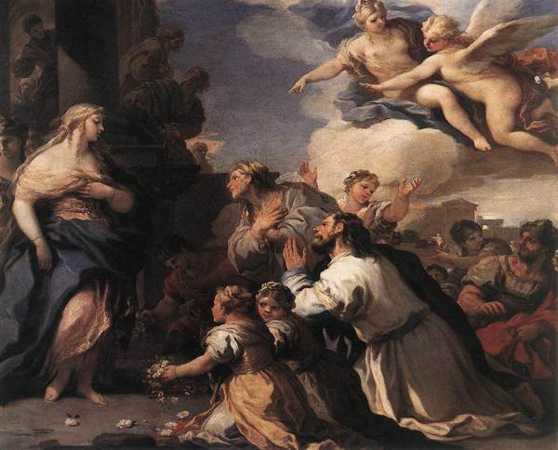
There were once a king and queen, who had three daughters of conspicuous beauty. The youngest and most beautiful was Psyche, whose admirers, neglecting the proper worship of the love goddess Venus, instead prayed and made offerings to her.
曾經有一個國王和皇后，有三個非常漂亮的女兒。最年輕的Psyche也是最漂亮的那一個，因為她太漂亮了，她的愛慕者們忽視對於女神Venus的崇拜。

Slide 5
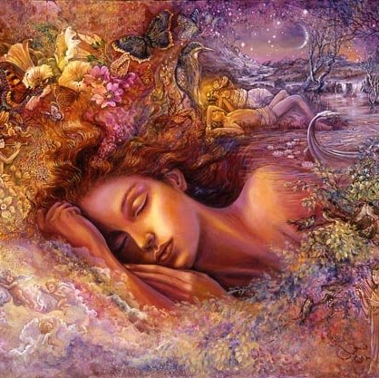
It was rumored that she was the second coming of Venus, or the daughter of Venus from an unseemly union between the goddess and a mortal. Venus is offended, and commissions Cupid to work her revenge.
謠傳她就是女神Venus轉世，或是Venus的女兒，但是把神跟一般人論唯一談是不禮貌的。Venus覺得自己被冒犯，並且命令Cupid去對Psyche報復。

Slide 6
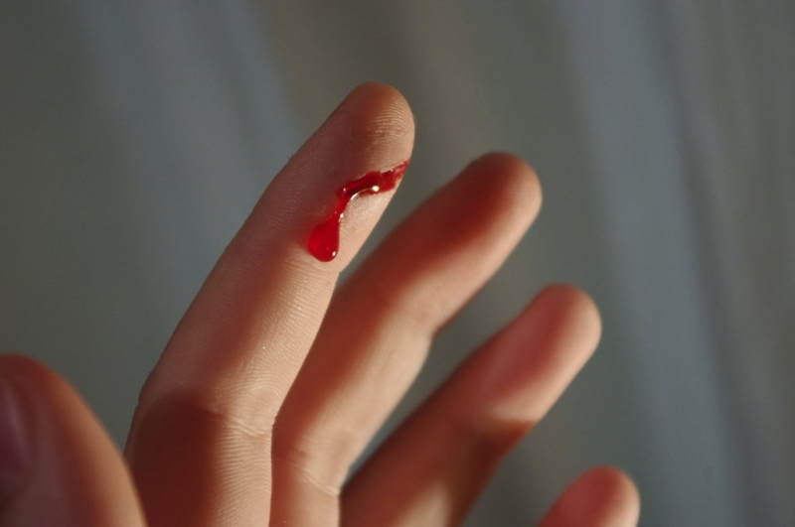
Cupid instead scratches himself with his own dart, which makes any living thing fall in love with the first thing it sees. As soon as Cupid scratches himself he falls deeply in love with Psyche and disobeys his mother's order to make Psyche fall in love with something hideous.
任何被Cupid的箭射到的人，會愛上看到的第一件事情，然而，他不小心被自己的箭給刮傷了， Cupid深深地愛上了Psyche，可是如此一來，祂就違反母親要讓Psyche愛上醜陋男子的命令。

Slide 7
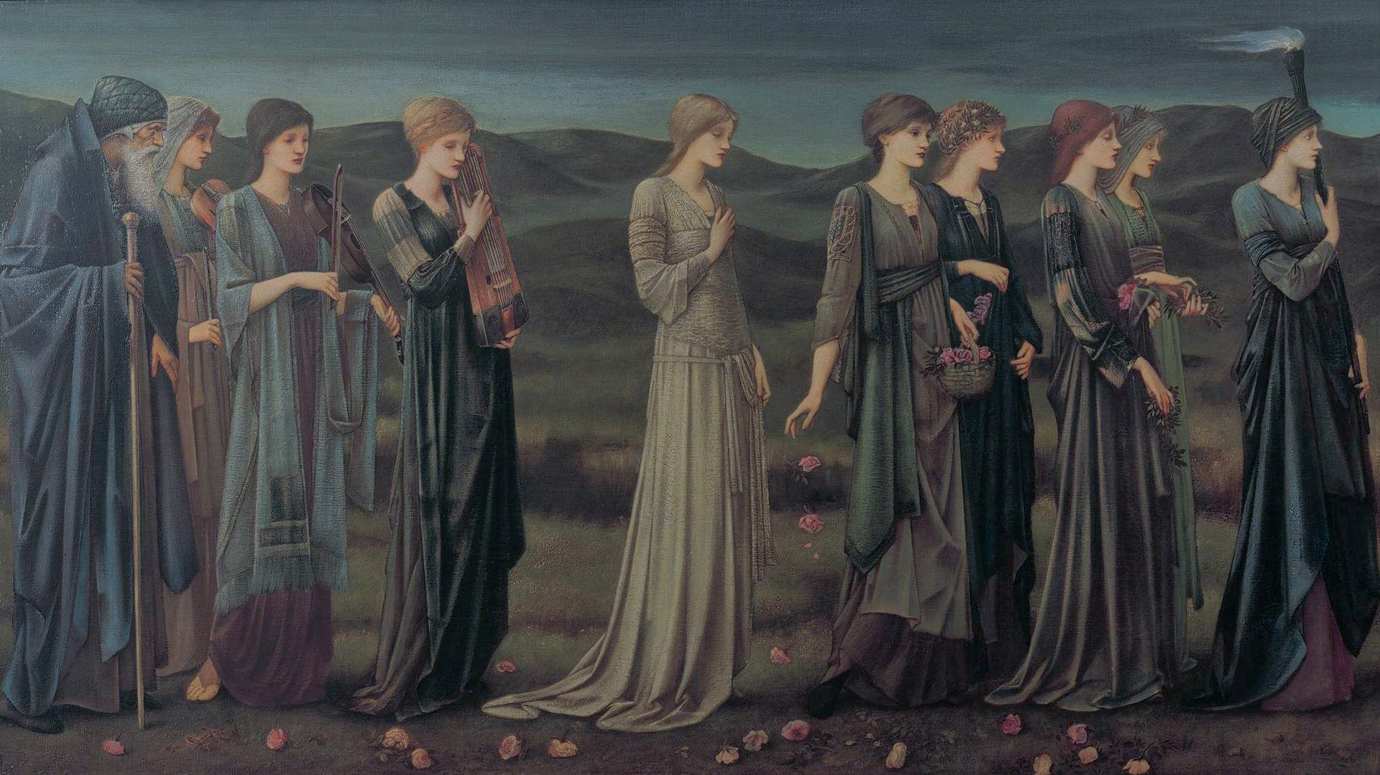
Although her two humanly beautiful sisters have married, the idolized Psyche has yet to find love. Her father suspects that they have incurred the wrath of the gods, and consults the oracle of Apollo. The response is unsettling: the king is to expect no human son-in-law, but rather a dragon-like creature who harasses the world with fire and iron and is feared by even Jupiter and the inhabitants of the underworld.
雖然她兩個美麗的姐妹已經結婚了，但是被當偶像崇拜的Psyche還沒有找到愛。她的父親懷疑他們是不是惹怒眾神了，並諮詢了太陽神Apollo。得到的反應令人不安的：國王未來的女婿不是個人類，而是像龍一般的生物，用火和鐵來騷擾世界，甚至Cupid和地獄的那些人也感到害怕。

Slide 8
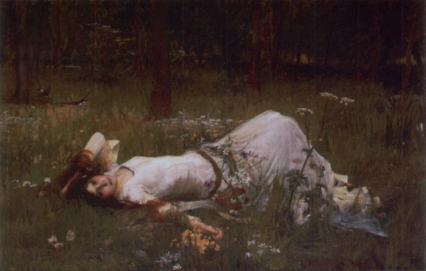
Psyche is arrayed in funeral attire, conveyed by a procession to the peak of a rocky crag. Marriage and death are merged into a single rite of passage, a "transition to the unknown". Zephyr, he West Wind bears her up to meet her fated match, and deposits her in a lovely meadow, where she promptly falls asleep.
Psyche被安排在葬禮上，隨著遊行到一個岩石碎片的高峰。婚姻和死亡被合併再一起。
Zephyr(風神)吹起了一陣風把她吹起吹到了命中注定的伴侶旁邊，並將她放在一個草地上，然後她馬上就睡著了。

Slide 9
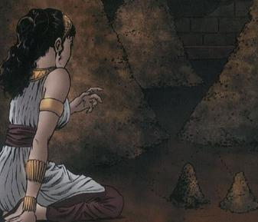
The girl awakes to find herself at the edge of a cultivated grove . Exploring, she finds a marvelous house with golden columns, a carved ceiling of citrus wood and ivory, silver walls embossed with wild and domesticated animals, and jeweled mosaic floors. A disembodied voice tells her to make herself comfortable, and she is entertained at a feast that serves itself and by singing to an invisible lyre.
Psyche醒來後發現自己躺在一個樹叢旁。她發現了一個奇妙的房子，有金色的柱子，天花板雕刻柑橘木和象牙，銀色的牆壁上浮雕著動物和珠寶鑲嵌的地板。一個無聲音告訴Psyche要讓自己放輕鬆，然後她享受著盛宴伴隨著無形的歌聲。

Slide 10
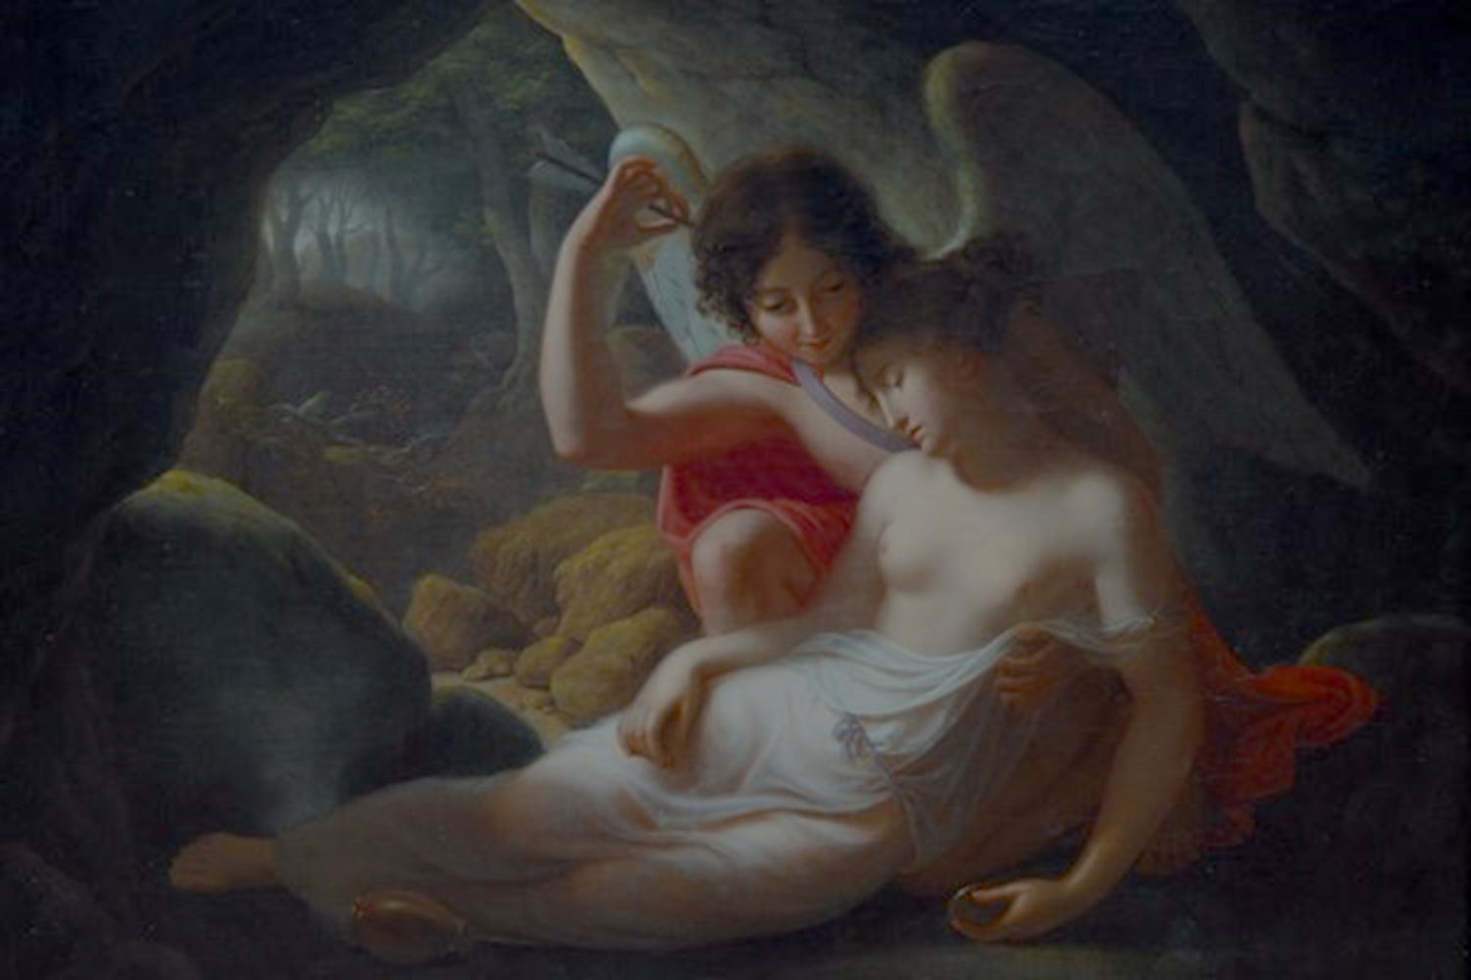
Although fearful and without sexual experience, Psyche allows herself to be guided to a bedroom, where in the darkness a being she cannot see makes her his wife.
She gradually learns to look forward to his visits, though he always departs before sunrise and forbids her to look upon him, and soon she becomes pregnant.
雖然害怕且沒有性經歷，Psyche讓自己被引導到臥室，在她看不到的黑暗處的那個人，是她的丈夫。 Psyche逐漸期待跟他的出現，雖然他總是在日出之前離開，並且不讓Psyche看到他的真面目，之後的她很快就懷孕了。

Slide 11
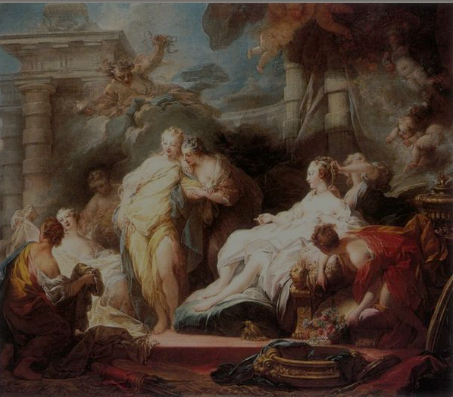
Psyche's family longs for news of her, and after much cajoling, Cupid, still unknown to his bride, permits Zephyr to carry her sisters up for a visit. When they see the splendor in which Psyche lives, they become envious, and undermine her happiness by prodding her to uncover her husband's true identity, since surely as foretold by the oracle she was lying with the vile winged serpent, who would devour her and her child﹒
Psyche的家人很久沒有她的消息了，經過多次哄騙，Psyche仍然不知道丘比特，允許Zephyr(風神)帶Psyche的姐妹來參觀。當他們看到Psyche住的金碧輝煌，他們變得非常羨慕，她的姊妹慫恿Psyche接露她丈夫的真實身份進而破壞她的幸福，並且很肯定地猜測躺在她旁邊的是一條長著翅膀會把她跟小孩吃掉的蛇。

Slide 12
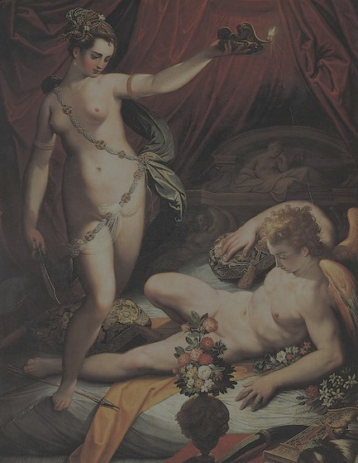
One night after Cupid falls asleep, Psyche carries out the plan her sisters devised: she brings out a dagger and a lamp she had hidden in the room, in order to see and kill the monster. But when the light instead reveals the most beautiful creature she has ever seen, she is so startled that she wounds herself on one of the arrows in Cupid's cast-aside quiver. Struck with a feverish passion, she spills hot oil from the lamp and wakes him.
在一個晚上，邱比特睡著後，Psyche執行了她姐妹設計的計劃：她把一把匕首和一盞燈隱藏在房間裡，以便能看到和殺死怪物。但是，當光線揭露怪物時，那個美麗的外表把她嚇著了，她不小心被邱比特放在一旁的箭給割傷。受到刺激後，她不小心從燈中濺出了熱油，燙醒了邱比特。

Slide 13
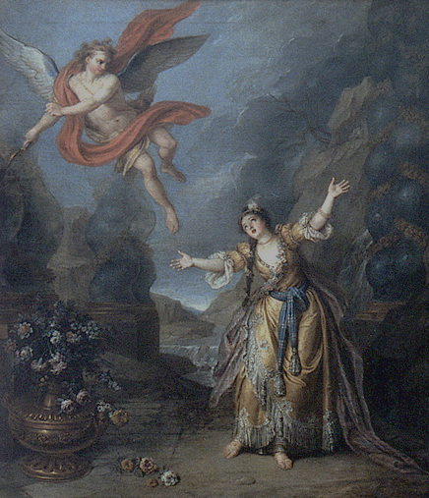
He flees, and though she tries to pursue, he flies away and leaves her on the bank of a river. She acknowledges his divinity , then begins to wander the earth looking for her lost love. Psyche visits first one sister, then the other; both are seized with renewed envy upon learning the identity of Psyche's secret husband.
邱比特逃跑，雖然Psyche試圖追著他，但他飛走了留下她在河岸。她了解Cupid是神，然後開始到處尋找她失去的愛情。Psyche後來拜訪了兩個姊妹，告訴他們那天看到的事情，兩個姊妹都非常的忌妒Cupid就是她的丈夫。

Slide 14
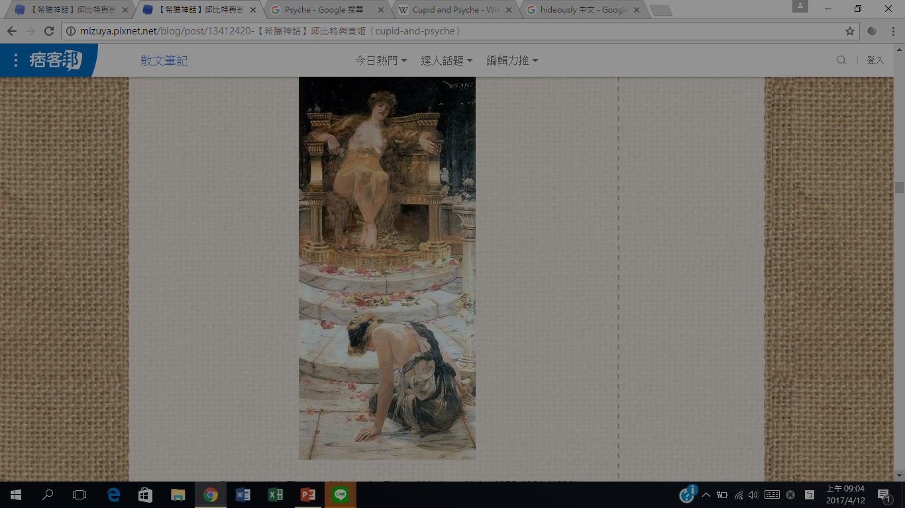
In the course of her wanderings, Psyche comes upon a temple of Ceres, and inside finds a disorder of grain offerings, garlands, and agricultural implements. Recognizing that the proper cultivation of the gods should not be neglected, she puts everything in good order, prompting a theophany of Ceres herself. Although Psyche prays for her aid, and Ceres acknowledges that she deserves it, the goddess is prohibited from helping her against a fellow goddess. Psyche realizes that she must serve Venus herself.
在他四處尋找的時候，Psyche來到了Ceres的寺廟，在裡面發現了看到了混亂的糧食、花環、農具，了解到種植到農作物的神識不能被忽視的，然後他把所有東西都整理整齊， 然後祈求Ceres希望可以幫助，Ceres被他誠摯的心感動，但是神是不能跟神作對的，Psyche了解她一定要自己為Venus效勞。

Slide 15
Venus revels in having the girl under her power, and turns Psyche over to her two handmaids, Worry and Sadness, to be whipped and tortured. Venus tears her clothes and bashes her head into the ground, and mocks her for conceiving a child in a sham marriage. The goddess then throws before her a great mass of mixed wheat, barley, poppyseed, chickpeas, lentils, and beans, demanding that she sort them into separate heaps by dawn. But when Venus withdraws to attend a wedding feast, a kind ant takes pity on Psyche, and assembles a fleet of insects to accomplish the task. Venus is furious when she returns drunk from the feast.
Venus沉迷於控制女生，將Psyche交給她的兩個女僕Worry 和Sadness，然後折磨、鞭打她。Venus脫光了她的衣服，然後將她毆打到地上並且嘲笑她。Venus扔大量混合的小麥，大麥，罌粟，鷹嘴豆，扁豆和豆類在她面前並要求她將它們分類乾淨。但是當Venus去參加結婚盛宴時，螞蟻對Psyche感到憐憫，帶著他一大批的蟲來完成Venus對Psyche的試驗。當Venus回來之後發現試驗已經完成她感到很不高興。

Slide 16
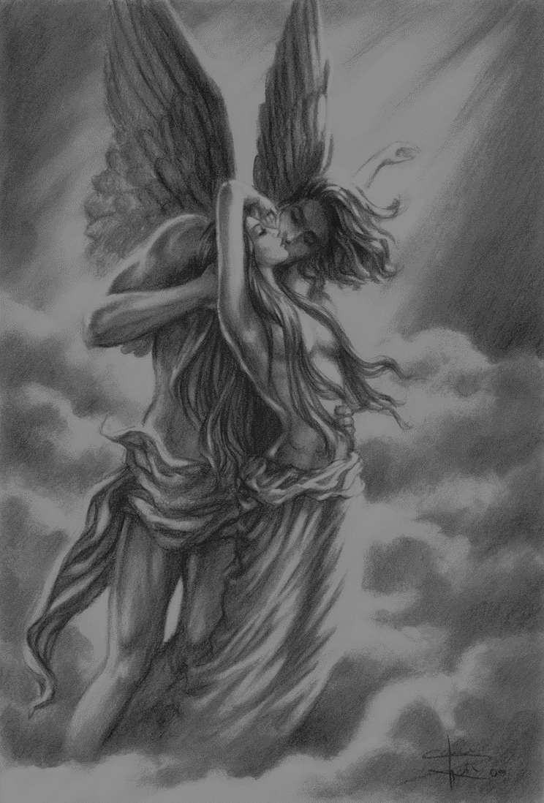
At dawn, Venus sets a second task for Psyche. She has to cross a river and fetch golden wool from violent sheep who graze on the other side. These sheep are elsewhere identified as belonging to the Sun. Psyche's only intention is to drown herself on the way, but instead she is saved by instructions from a divinely inspired reed, of the type used to make musical instruments, and gathers the wool caught on briers.
黎明時，Venus給了Psyche第二個任務。他必須跨越河流在一種性情很暴躁的羊身上收集金色的毛。這些羊在別的地方被認為是屬於太陽的羊。Psyche覺得絕望就想在跨越的河流當中自殺，然後在途中被神啟發用一種製造樂器的蘆葦來取得羊毛。

Slide 17
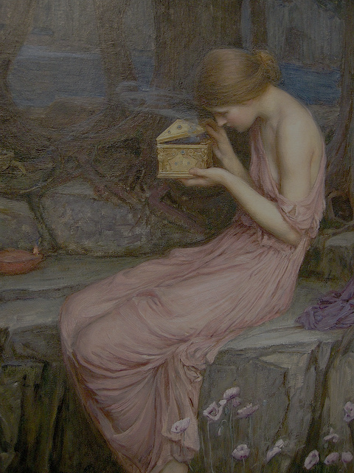
For Psyche's third task, she is given a crystal vessel in which to collect the black water spewed by the source of the rivers Styx and Cocytus. Climbing the cliff from which it issues, she is daunted by the foreboding air of the place and dragons slithering through the rocks, and falls into despair. Jupiter himself takes pity on her, and sends his eagle to battle the dragons and retrieve the water for her.
第三個測試，她要拿著水晶船收集Styx和Cocytus吐出來的黑水，但是在爬懸崖壁的時候，他被龍給嚇到了，不小心踩到了石頭掉了下來，陷入了絕望。Cupid憐惜她，他派他的老鷹去跟龍戰鬥並且幫Psyche完成他的任務。

Slide 18
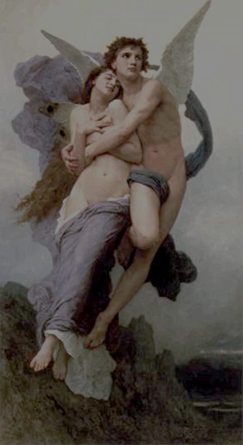
最後 Cupid被Psyche深深地打動 離開了Venus並且與Psyche結婚。

Slide 19
THE END

